Slide 1
CS3210 Lab 2
Parallel Programming with OpenMP & Performance Instrumentation
Theodore’s slides; heavily inspired by Sriram’s and Zhi Heng’s slides.

Slide 2
Calibration / Improvements
After previous tutorial :)

Slide 3
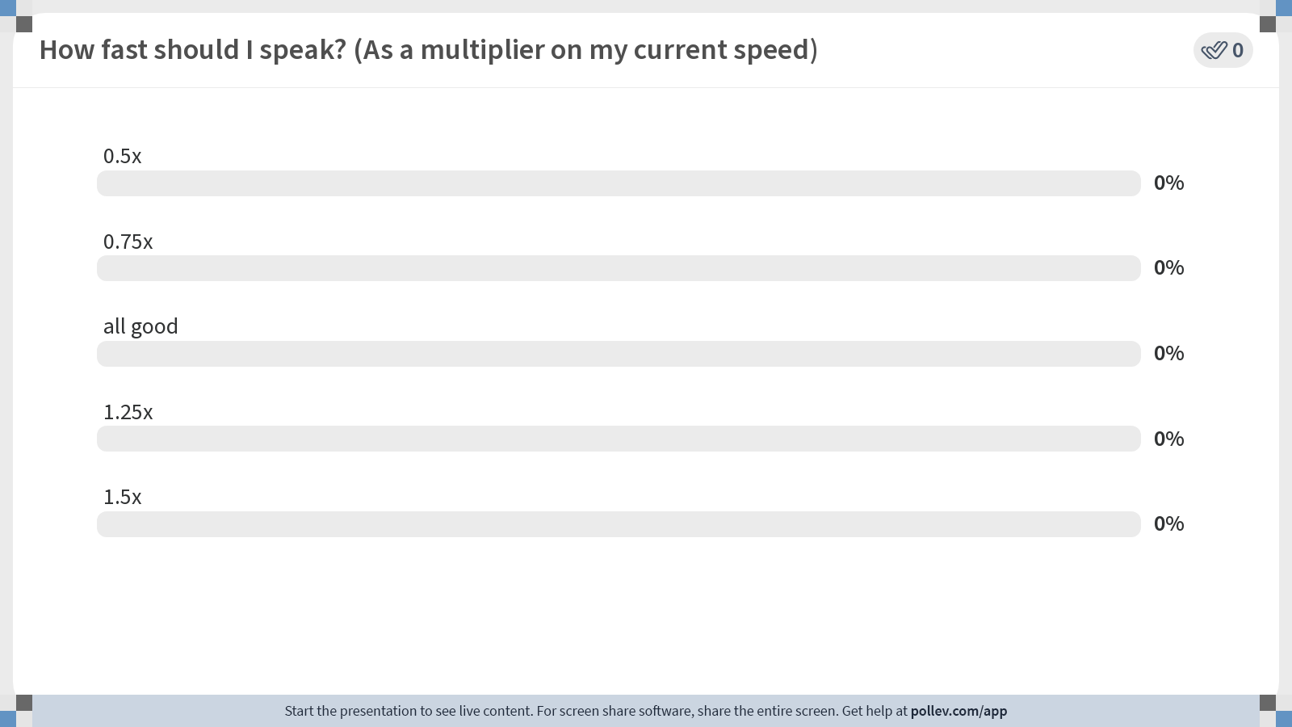
Notes:
Poll Title: Do not modify the notes in this section to avoid tampering with the Poll Everywhere activity. More info at polleverywhere.com/support How fast should I speak? (As a multiplier on my current speed) https://www.polleverywhere.com/multiple_choice_polls/6EYnBmlge9Q1wu3RbcjMX?state=opened&flow=Default&onscreen=persist

Slide 4
Lab 1 Feedback
hopefully all the submissions are marked by this lab session

Slide 5
Lab 1 Feedback
Everyone gets passing marks :)
How we grade in this course might or might not be similar to others
Still read the comments in the pdf
Some comments:
Keep critical section small
Main culprit: print statements
shmget copy-pasting
Try to minimize; put into structs if possible for better locality

Slide 6
Feedback 1: Keeping critical sections small
Do:
LOCK(m)
Minimal work…
UNLOCK(m)
Do not:
LOCK(m)
rand()/printf()...
other things that costs cycles unnecessarily
UNLOCK(m)
Printing stuff (especially in the critical section) can waste cycles.
Minimize the amount of IO in your program before benchmarking!

Slide 7
Tip: -DDEBUG flag
In your code:
#ifdef DEBUG printf("This program is compiled with -DDEBUG!"); #endif printf("Hello world!");
Specify in your compilation command/Makefile to compile with DEBUG flag:
g++ -DDEBUG my_code.cpp -o my_program
Will print both statements!

Slide 8
Common Issue 2: Shmget copy paste
Do: // I want to store a and b in shared memory struct shm_data { int a; int b; } data = shmget… (sizeof(struct shm_data))
Do not: // I want to store a and b int* a = shmget… int* b = shmget… // or, manually index into shm: shm = shmget…; shm[0] = 5…
Fewer shm regions, better locality / caching, etc.

Slide 9
"How to write report"
Understand the skills we are trying to teach
Start with benchmarking
==> Getting aggregated results
==> Having a hypothesis on results
==> Testing the given hypothesis
==> Improving your code
==> Back to benchmarking

Slide 10
"How to write report"
Understand the skills we are trying to teach
Start with benchmarking
==> Getting aggregated results
==> Having a hypothesis on results
==> Testing the given hypothesis
==> Improving your code
==> Back to benchmarking
Lab 1

Slide 11
"How to write report"
Understand the skills we are trying to teach
Start with benchmarking
==> Getting aggregated results
==> Having a hypothesis on results
==> Testing the given hypothesis
==> Improving your code
==> Back to benchmarking
This is the basis of your performance analysis.
Use whichever tools you want to use that might help – be it time, perf, hyperfine, etc.
In this step, we need to get raw data. Might or might not necessarily need to see individual data points in the final report
Put raw data in appendix
Put in a easily-digestible form

Slide 12
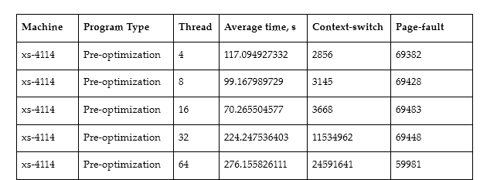
"How to write report"
Understand the skills we are trying to teach
Start with benchmarking
==> Getting aggregated results
==> Having a hypothesis on results
==> Testing the given hypothesis
==> Improving your code
==> Back to benchmarking
Data from my A1 in 2022 Results averaged from 10 runs

Slide 13
"How to write report"
Understand the skills we are trying to teach
Start with benchmarking
==> Getting aggregated results
==> Having a hypothesis on results
==> Testing the given hypothesis
==> Improving your code
==> Back to benchmarking
This is the part where you show the results of the data in an aggregated manner.
The laziest is to put screenshots of perf/time/whatever in your report
Please don't :((((
Use graphs to your advantage here.
Usually you want to see trends; how does your program benchmark…
across different machines?
across different input sizes?
across different algorithms?
Note:
Don't worry about advanced statistical methods in this module.

Slide 14
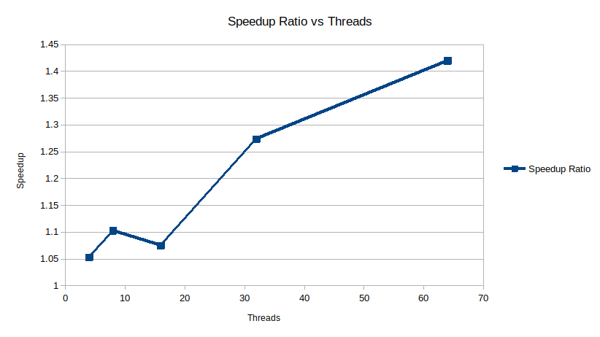
"How to write report"
Understand the skills we are trying to teach
Start with benchmarking
==> Getting aggregated results
==> Having a hypothesis on results
==> Testing the given hypothesis
==> Improving your code
==> Back to benchmarking
Graph from previous data
Note: this graph is alright, but there are still quite some improvements which can be made:
Error bars / standard deviation
Scale of axis; log scale might be better for x-axis

Slide 15
"How to write report"
Understand the skills we are trying to teach
Start with benchmarking
==> Getting aggregated results
==> Having a hypothesis on results
==> Testing the given hypothesis
==> Improving your code
==> Back to benchmarking
Make it clear that you're putting forth your hypothesis
Hypothesis needs to be plausible!
Make sure you remove common issues before you even get to this point
sleep, print statements, etc.

Slide 16
"How to write report"
Understand the skills we are trying to teach
Start with benchmarking
==> Getting aggregated results
==> Having a hypothesis on results
==> Testing the given hypothesis
==> Improving your code
==> Back to benchmarking
A good hypothesis doesn't come out of thin air, but backed up by data
Common points: perf, flamegraphs

Slide 17
"How to write report"
Understand the skills we are trying to teach
Start with benchmarking
==> Getting aggregated results
==> Having a hypothesis on results
==> Testing the given hypothesis
==> Improving your code
==> Back to benchmarking
(modified) excerpt from prev A1
In every single test on the Xeon machine, with an increasing number of threads, there is a speedup - up until a certain point where it suddenly has a large slowdown.
This might happen due to contention on the processing unit which happening due to having too many threads.
Figure A6 sheds some insight into this - once the number of threads is larger than 16, there is a huge increase in the number of context-switches, which is a good indicator of contention and would incur a large penalty in time taken.

Slide 18
"How to write report"
Understand the skills we are trying to teach
Start with benchmarking
==> Getting aggregated results
==> Having a hypothesis on results
==> Testing the given hypothesis
==> Improving your code
==> Back to benchmarking
This goes hand-in-hand with the previous point; if you suspect that something is causing your code to be slow, change it (if possible)
Now you have a new version of code that performs better ☺
Unlocks a new benchmarking data point
Also unlocks comparison across versions

Slide 19
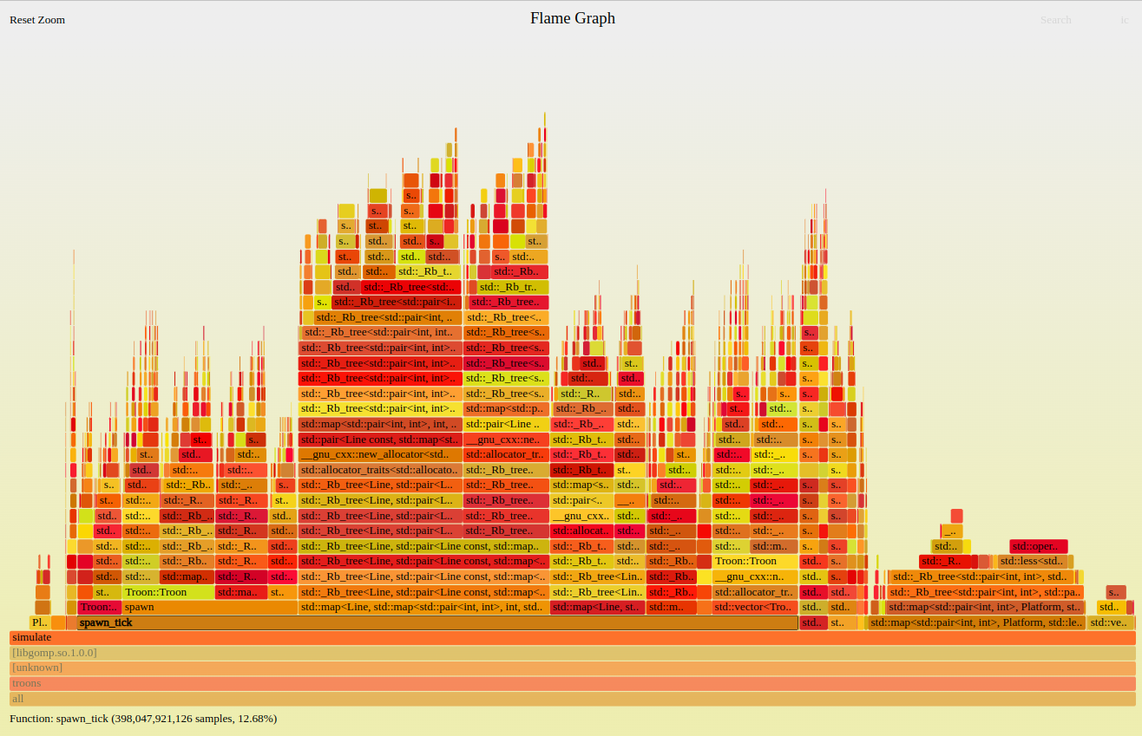
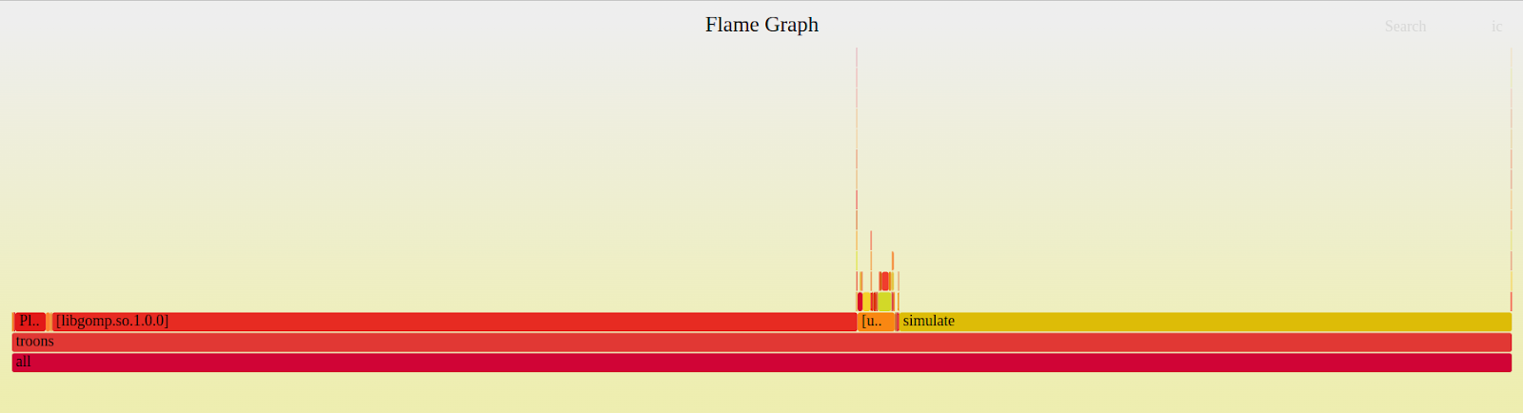
"How to write report"

Slide 20
Quick Recap + Revisiting
Previous tutorial, lectures

Slide 21
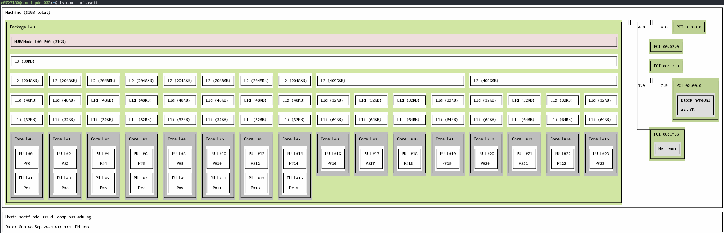
lstopo on heterogeneous processor (i7-13700)
Recall: i7-13700 has 8x P-cores and 8x E-cores

Slide 22
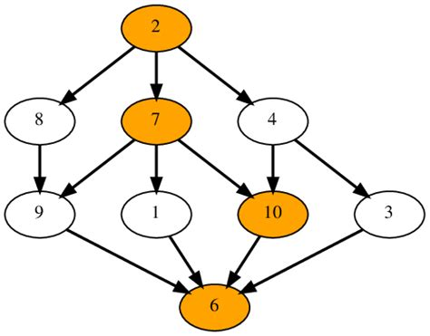
Recap
Parallel Programming Models I (Lec 4 & Lab 2)
Coordination models
Shared address space
Data parallel
Message passing
Data vs Task Parallelism
Task Dependence Graphs
Foster's Design Methodology
Partitioning ⬇️ Communication ⬇️ Agglomeration ⬇️ Mapping
Parallel Patterns
Fork-join
Parbegin-Parend
SIMD/SPMD
Master-Worker
Task Pools
Producer-Consumer
Pipelining

Slide 23
Prelude to Tutorial
I. OpenMP

Slide 24
OpenMP's parallel pattern
What kind of parallel pattern does OpenMP use? [p]
Fork-Join
Client-Server
Task pool
Producer-consumer
Parbegin-Parend

Slide 25
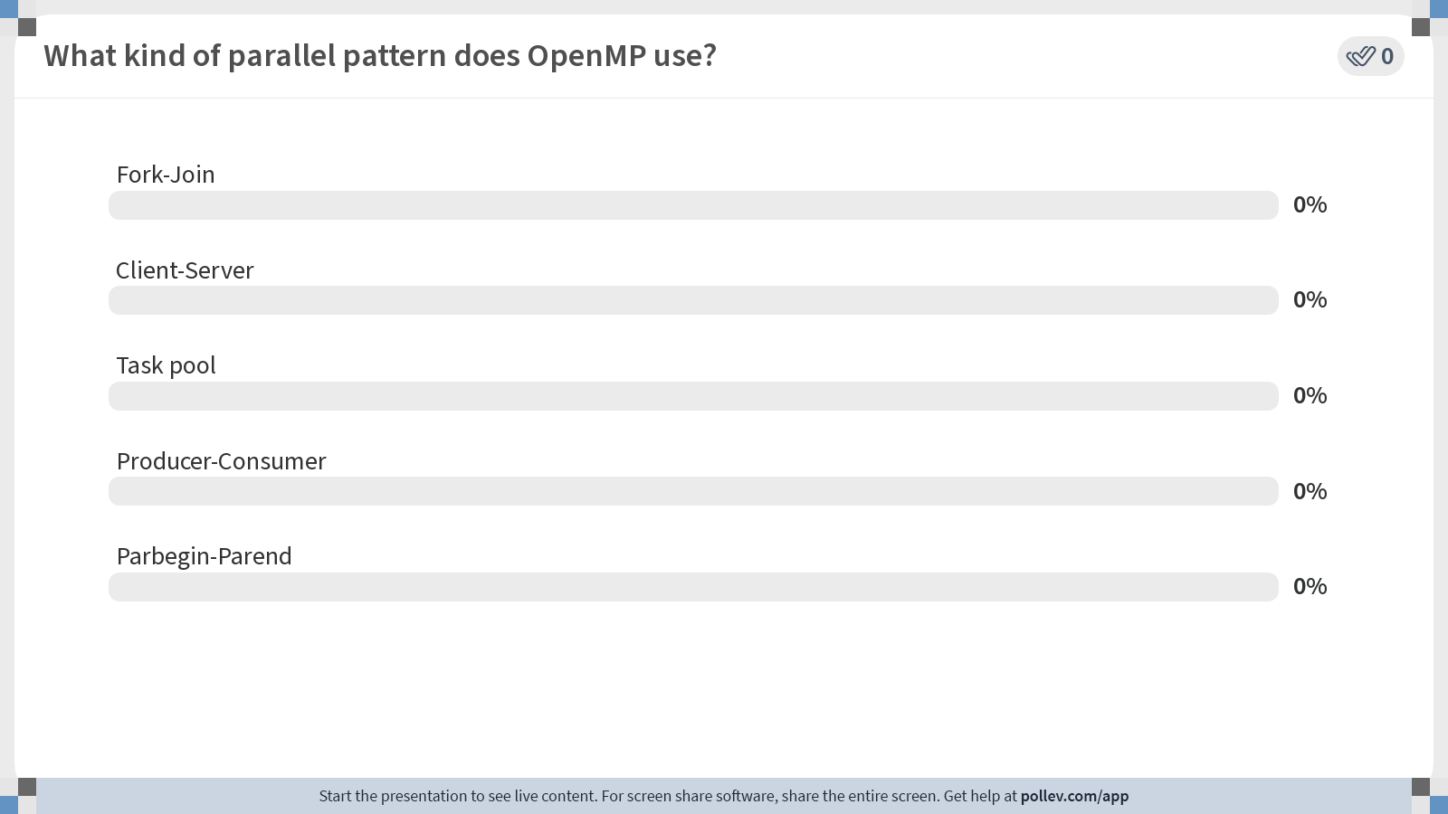
Notes:
Poll Title: Do not modify the notes in this section to avoid tampering with the Poll Everywhere activity. More info at polleverywhere.com/support What kind of parallel pattern does OpenMP use? https://www.polleverywhere.com/multiple_choice_polls/PIfzBBNOC9q2rnbfjbFY5?state=opened&flow=Default&onscreen=persist

Slide 26
OpenMP's parallel pattern
What kind of parallel pattern does OpenMP use?
Fork-Join (Mainly how OpenMP works in the backend)
Client-Server
Task pool
Producer-consumer
Parbegin-Parend (Mainly what you, as a programmer, will do in your code)

Slide 27
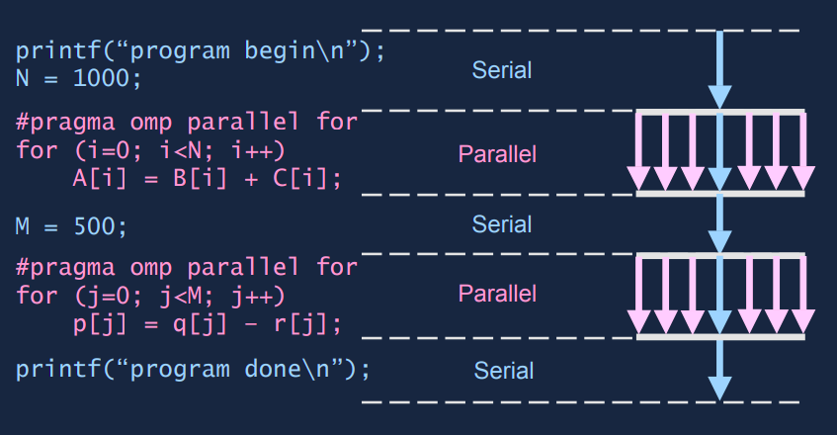
OpenMP's parallel pattern

Slide 28
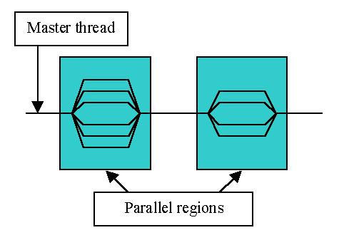
What is OpenMP?
Compiler directives that help you parallelize parts of your code easily!
TL;DR: Add "#pragma omp …" above your parallelizable code.

Slide 29
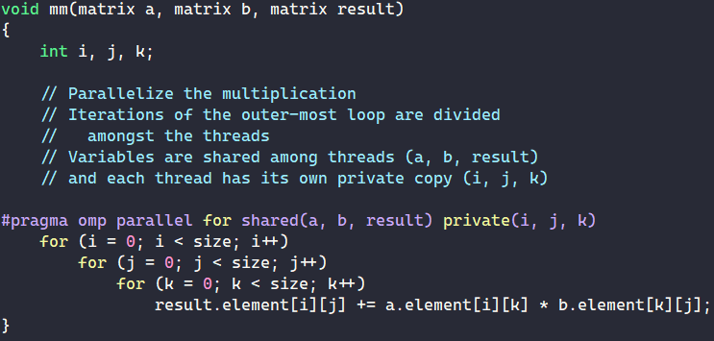
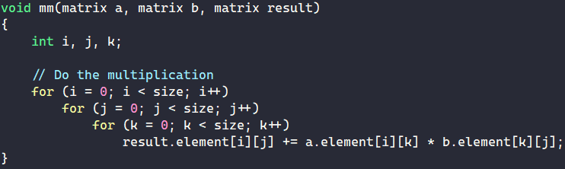
What is OpenMP?
Main usage: Parallelize for loops!
Use #pragma omp to tell the compiler to generate parallel code for the code block below.
All threads will wait for each other before continuing (implicit barrier).
Sequential (mm-seq.cpp)
OpenMP (mm-omp.cpp)

Slide 30
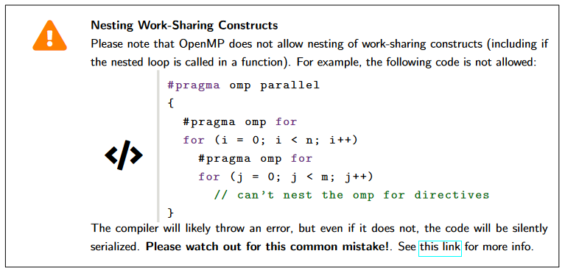
Warning: OpenMP Nesting
Nesting might lead to unexpected results!
New feature: OMP_NESTED environment variable as flag
Unfortunately, will not be enabled
Workaround: use collapse(2)
Notes:
Works if OMP_NESTED environment flag is enabled, but we will not enable the flag when we test code. Use `collapse(2)` instead.

Slide 31
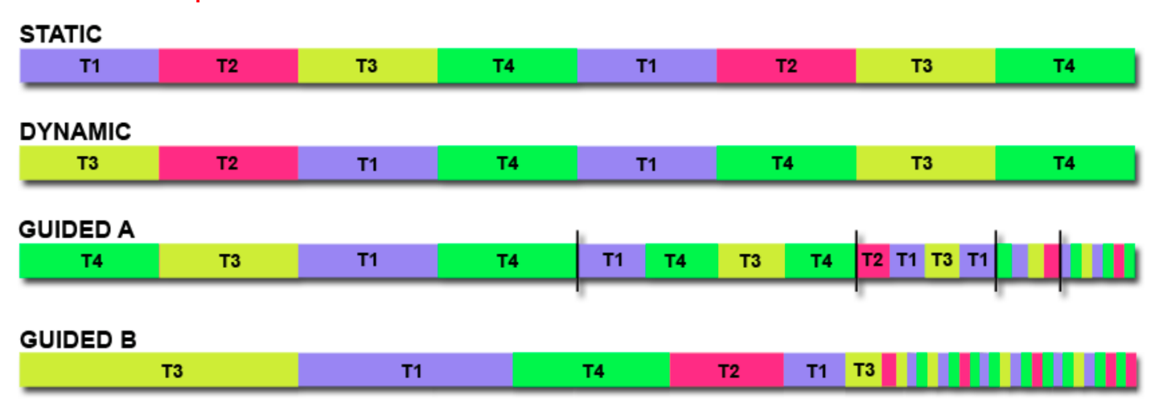
OpenMP: Controlling work per thread
We can control how loop iterations are given to threads.
Static: Array is split into equal chunks, each thread is pre-allocated a fixed chunk of the array in round-robin fashion
Less overhead, great if work size is approximately equal
Dynamic: Fixed size chunks are dynamically allocated to idle threads during runtime
Good for unpredictable work times, but more overhead

Slide 32
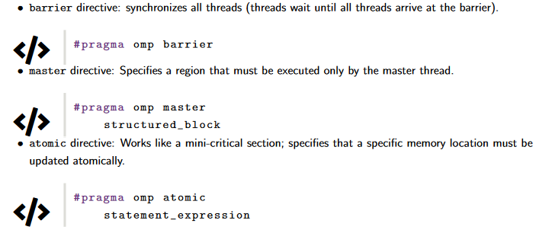
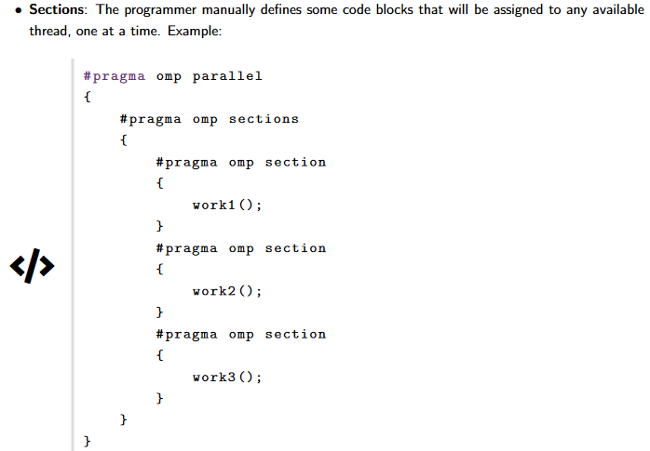
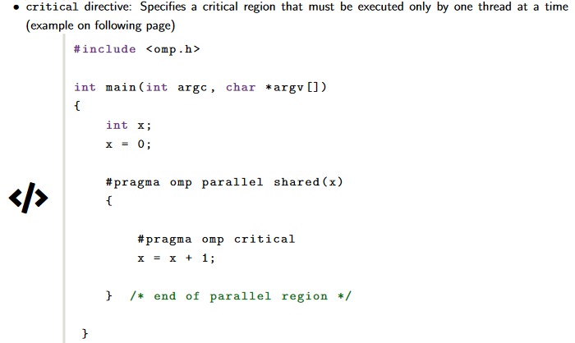
OpenMP constructs
Useful constructs for your exploration here & in Assignment 1:

Slide 33
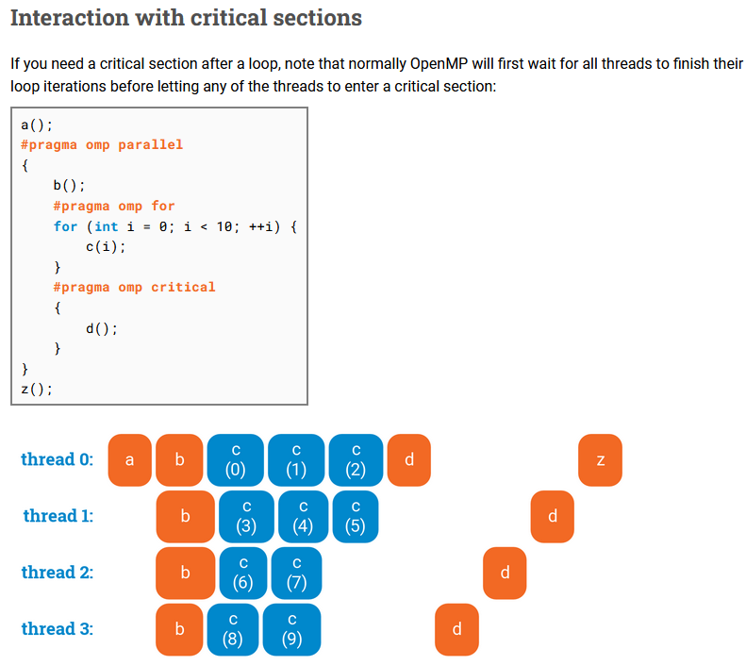
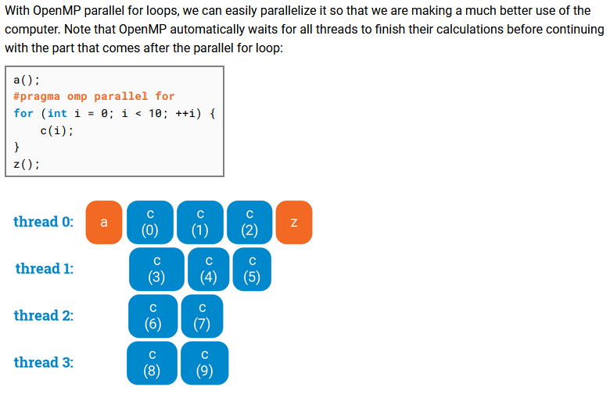
OpenMP: visual guides
https://ppc.cs.aalto.fi/ch3/ (link should be in your lab sheet)

Slide 34
Prelude to Tutorial
II. perf

Slide 35
What is perf?
Unified interface to collect performance statistics from Linux from 2 sources:
Hardware counters (from performance measurement unit [PMU])
e.g. cache misses, branch misses, instructions, …
Software counters (provided by Linux kernel)
e.g. page faults, cpu-migrations, …

Slide 36
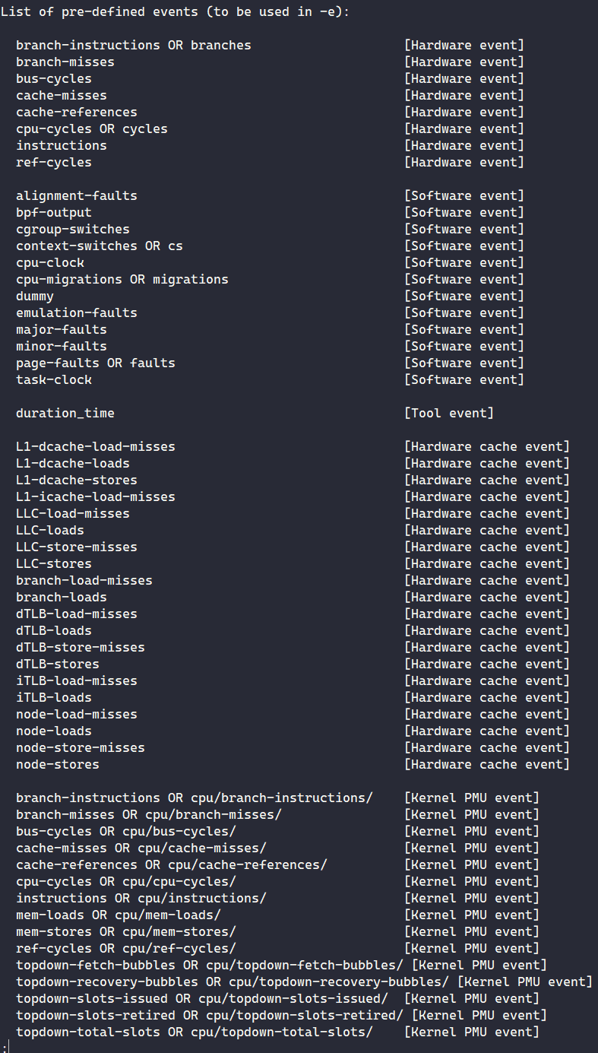
perf events
Get list of events that perf can measure via perf list
Differs for Linux kernels + Hardware types
Example usage: perf stat -- ls
Do not be too alarmed by the huge list of events - the lab sheet will guide you to measure events that are more important for this course.

Slide 37
Live Demo: Tut 1's pthread_addsub results
*Base clock speed, different from tutorial 1 slides
Rebenched w/ perf instead of hyperfine.
4C/8T i7-7700 CPU @ 3.60GHz*: 5.565s
8C/8T i7-9700 CPU @ 3.00GHz*: 6.374s
10C/20T Xeon Silver 4114 @ 2.20GHz*: 6.8194s
8C/16T Xeon W-2245 @ 3.90GHz*: 5.21152s
16C/24T i7-13700 @ 2.10GHz* (P-core), 1.50GHz* (E-core): 1.3826s
For me: cd ~/tut1 tail -n +1 *.out
Why does i7-7700 run faster than i7-9700 & Xeon 4114? Why is i7-13700 the fastest here?

Slide 38
Live Demo: Tut 1's pthread_addsub results
Commands to replicate results:
g++ -o pthread_addsub pthread_addsub.cpp
srun -p i7-7700 perf stat -r 3 ./pthread_addsub > /dev/null 2> i7-7700.out
srun -p i7-9700 perf stat -r 3 ./pthread_addsub > /dev/null 2> i7-9700.out
srun -p xs-4114 perf stat -r 3 ./pthread_addsub > /dev/null 2> xs4114.out
srun -p xw-2245 perf stat -r 3 ./pthread_addsub > /dev/null 2> xw-2245.out
srun -p i7-13700 perf stat -r 3 ./pthread_addsub > /dev/null 2> i7-13700.out
Notes:
EASTER EGG HERE: If you are reading this and wondering why we pipe the output of pthread_addsub to /dev/null instead of removing the printf statements from code, it is because removing printf statements causes a slowdown. I'm still not too sure why, Peigeng suggested it may be due to this: https://stackoverflow.com/questions/42358211/adding-a-print-statement-speeds-up-code-by-an-order-of-magnitude but I still couldn't get rid of the slowdown despite following the suggestions in the answer.

Slide 39
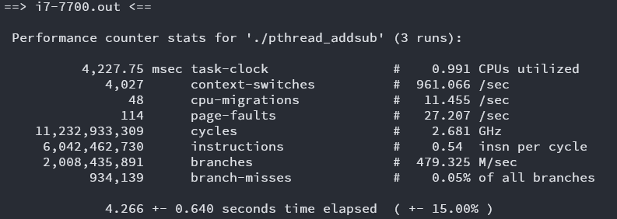
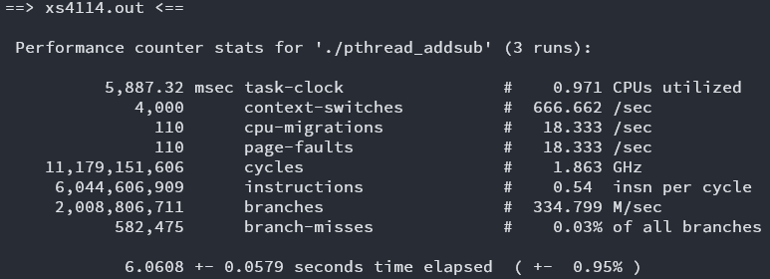
Live Demo: Tut 1's pthread_addsub results
i7-7700 @ 3.60Ghz
xs-4114 @ 2.20GHz
i7-7700 wins due to higher clock speed (& thus having higher single-threaded performance)

Slide 40
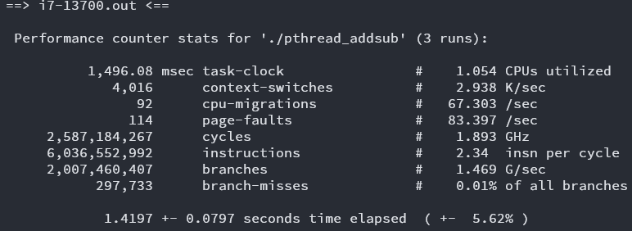
Live Demo: Tut 1's pthread_addsub results
i7-7700
i7-13700
i7-13700 wins due to its superior IPC & branch prediction! (despite having slower average clock speed)

Slide 41
Today's Problem: Matrix Multiplication
Can you see how it can be parallelized?

Slide 42
Getting started
wget the lab from pdc (link in PDF)
Please use srun or sbatch to run your programs from Ex3 and onwards.

Slide 43
Lab time!
Ex1 + Ex2: Matrix Mult w/ OpenMP
Ex3: System differences w/ OpenMP
Ex4: Static vs Dynamic schedules
Ex5: OpenMP sections
Ex6: Synchronization in OpenMP
Ex7: Profiling w/ perf
Ex8 + Ex9: perf w/ Slurm
Ex10: IPC & MFLOPS vs no. of threads
Ex11: Matrix Mult optimization
Ex12: Benchmarking Ex11
Quick taste of OpenMP
OpenMP exercises
perf exercises
(Some tidbits provided later)
For submission (by next Wed 2pm)
Notes:
Demo ex9 at the end

Slide 44
Extra Content
perf subsampling
Notes:
INCLUDES HINTS FOR EX10

Slide 45
Live Demo: perf -M vs perf -e
perf -M
perf stat -M GFLOPs python3 -c 'print(2.0 / 5.0)'
srun -- hostname; perf stat -M GFLOPs python3 -c 'print(2.0 / 5.0)'
Run multiple times
perf -e
perf stat -e fp_arith_inst_retired.scalar_double python3 -c 'print(2.0 / 5.0)'
srun -- hostname; perf stat -e fp_arith_inst_retired.scalar_double python3 -c 'print(2.0 / 5.0)'
Run multiple times
What is causing this inconsistency?

Slide 46
Live Demo: perf -M vs perf -e
What if we try replicating perf -M with perf -e?
perf stat -e fp_arith_inst_retired.scalar_single,fp_arith_inst_retired.scalar_double,fp_arith_inst_retired.128b_packed_double,fp_arith_inst_retired.128b_packed_single,fp_arith_inst_retired.256b_packed_double python3 -c 'print(2.0 / 5.0)'
What happens?

Slide 47
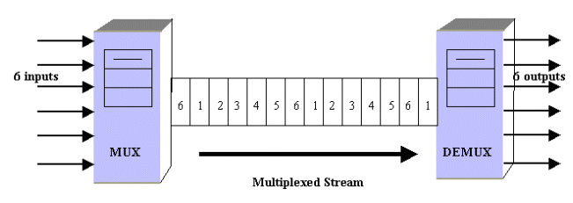
Live Demo: perf -M vs perf -e
If there are not enough hardware counters: perf multiplexes the events (i.e. subsampling) and estimates the counts based on execution time!

Slide 48
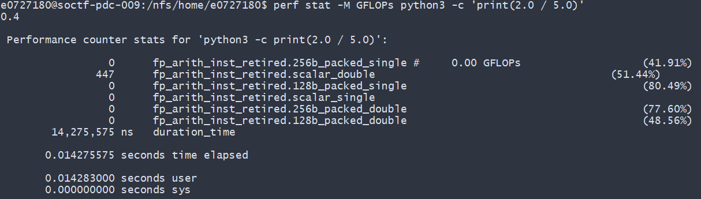
% sign in perf readings
Usually means that the reading is subsampled.
Signifies % of time spent measuring the specific event.
https://stackoverflow.com/questions/33679408/perf-what-do-n-percent-records-mean-in-perf-stat-output

Slide 49
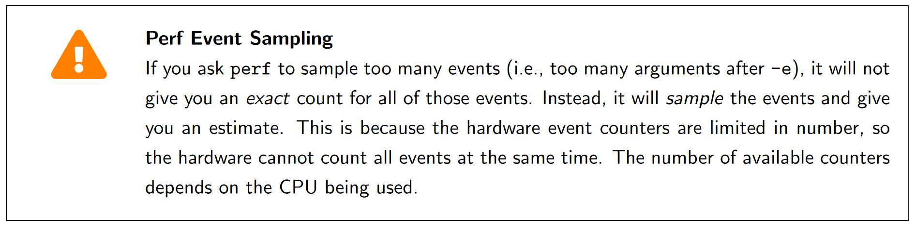
perf subsampling
Basically a warning to prevent what happened previously

Slide 50
Disclaimers for Ex 11: Optimizing matrix multiplication
We are not concerned about total correctness.
The values for the matrices are generated randomly.
There is NO NEED to transpose the matrices! (you can assume a matrix is already transposed)
There are multiple solutions possible.
As long as the order of access fulfills the criteria of row-wise access.

Slide 51
Summary
OpenMP
perf usage
Using Slurm with OpenMP and perf

Slide 52

End of lab 2
Slides uploaded!
Feedback: bit.ly/feedback-theodore or scan below
Email: theo@comp.nus.edu.sg

